Slide 1

Image Forgery Detection
Computer Vision IE-1 Presentation on
Combining the local features extracted by Bernsen thresholding technique with global features extracted from TSBTC N-ary technique.
By
Sugam N. Phirke, TYCOB152
Shreyash Kharde, TYCOB102
Ishwar Deore, TYCOB147
Dattatray Pandharmise, TYCOB141
Department of Computer Engineering
PCET’s Pimpri Chinchwad College of Engineering

Slide 2
OUTLINE
Introduction
Problem Definition
Motivation & Scope of work
Objectives
Literature Survey
Proposed Architecture
Experimental Environment
Results of Implementation
Conclusion
References

Slide 3
PROBLEM DEFINITION
In 2022, the total figure of smartphone holders in the world have reached 6.648 billion, which translates to 83.32% of current world population.
As of April 2022, estimates say that there are over 5 billion people on the internet, who create 1.7 MB of data/second, on average.
With the development of advanced image modification technologies, it is now possible to produce forgeries that are unnoticeable to naked human eye.
Consequently, a method that can quickly and precisely identify any hidden forgeries in picture is pressing priority.

Slide 4
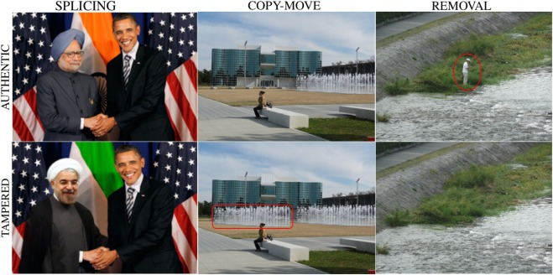
MOTIVATION

Slide 5
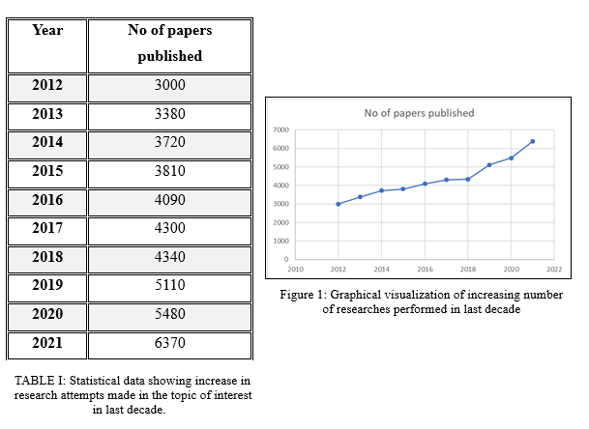

Slide 6
SCOPE
Some of identified thrust areas of topic include:
Image Forensics
Journalism(fake news dectection)
Scientific Publications
To authorize presented image evidences in Legal trials
Military assistances
Medical Imaging
Social Media content filtration
Archaeological Surverys(Fact checking)
Crime Investigations

Slide 7
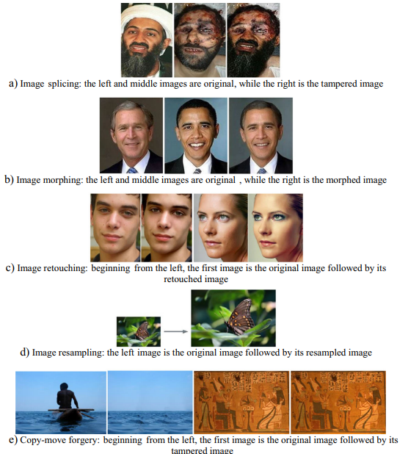

Slide 8
OBJECTIVES
To propose and study a novel feature level fusion methodology to detect image forgery.
To learn about the existing techniques available and perform systematic analysis on them.
To evaluate the performance of classifications made by various classifiers and their ensembles for publicly available datasets like MICC-F220, 600, 2000.
To discuss/prove the performance appraise of proposed model with respect to the individual traditional methods.

Slide 9
LITERATURE SURVEY
Reference 1 | Splicing image forgery identification based on artificial neural network approach and texture features
Objectives | To identify the spliced image by exploiting the image texture features, and to automatically identification of spliced images
Proposed Architecture | To accurately identify the spliced image, the proposed solution uses different texture features to capture deferent texture related to the edge of the object and the colour features.
Results | Two models have been proposed in this paper first combine the vectors of the three features and feed them to the ANN classifier. Second, use the majority voting of the result of three features to take the decision.
Advantages | The identification accuracy in the technique used is about 98.06% with 99.03% sensitivity.
Limitations | The specificity is about 96.07%

Slide 10
Reference 2 | Robust forgery detection for compressed images using CNN supervision
Objectives | To present a framework improving robustness for image forgery detection
Proposed Solution | To take into account the image quality corresponding to the chosen application. Therefore, the solution relies on a camera identification model based on CNN.
Results | Lossy compression such as JPEG found as the most common type of intentional or inadvertent concealment of image forgery
Advantages | Study led to a more robust and accurate framework
Limitations | Interpreting the extracted camera identification model is very difficult. Another drawback of using CNN is the model is dedicated to a specific training dataset.

Slide 11
Reference 3 | Thepade’s Sorted Block Truncation Coding Applied on Local Binary Patterns of Images for Splicing Identification Using Machine Learning Classifiers
Objective | To improve the detectability of forged images.
Proposed model | Extract the features using LBP and Thepade’s SBTC and pass it to various machine learning models to train
Results | The investigation is carried out on the following datasets: CASIA V1, Columbia, and Columbia Uncompressed Dataset.
Advantages | TSBTC and LBP for r=1(8 neighbours) combination perform better than TSBTC and LBP for r=2(16 neighbours). 12­ ary TSBTC and LBP for r=1 combination performs better closely followed by 14-ary and 16-ary for r=1.
Limitations | The proposed method works better for monochrome images but is not efficient for multi-chrome images.

Slide 12
Refernce 4 | Land Usage Identification with Fusion of Thepade SBTC and Sauvola Thresholding Features of Aerial Images Using Ensemble of Machine Learning Algorithms
Objectives | To improve the efficiency in identification of land usage using aerial images
Proposed Model | Features were extracted using two technique viz. TSBTC N-ary and Sauvola Thresholding method and then passed to multiple Machine learning classifiers to get the results
Results | Experimentation done on 2100 images of UC merced land usage of aerial images dataset shows higher identification accuracy, higher Matthews Correlation Coefficient (MCC) and higher F Measure values in feature level fusion as compared to individual features proving the worth of proposed technique.
Advantages | Result generated was generalized.
Limitations | Overall accuracy obtained was less than 70%.

Slide 13
Reference 5 | Copy-Move Forgery Detection Based on Deep Learning
Objectives | To study the efficiency of detecting the forged images using CNN.
Proposed Model | The authors built a dataset containing 10000 computer spliced images and used CNN model to train the features extracted using the Caffe architecture.
Results | Experimental results showed that the proposed model obtained good performance to the forgery images generated by computer with simple copy move operation.
Advantages | The dataset contained 10000 tampered images. Large dataset like ImageNet was used.
Limitations | It is not robust to the copy-move forgery image of real scenario

Slide 14
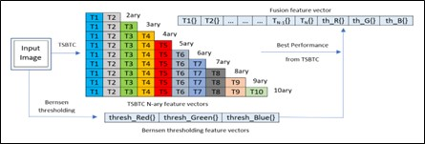
PROPOSED ARCHITECTURE
The fundamental concept behind this approach is to combine the features extracted from Thepade's SBTC and Bernsen thresholding technique to form a feature vector and investigate its behaviour in relation to various Machine learning algorithms and their ensembles.

Slide 15
Thepade’s Sorted Block Truncation Code(SBTC) technique
This global feature extraction technique takes images as input.
The R, G, B colour channels are extracted from the input image for each pixel and flattened to a one dimensional array.
This array is then sorted in ascending order.
To generate the resultant N-ary feature vectors, (here in our studies, we will assume N ϵ {2,…,10}), split the obtained array in approximately equal N parts.
Later to it, N vectors for each channel [R₁, R₂, … , R_{N}; G₁, G₂, …, G_{N}; B₁, B₂, … , B_{N}] are generated by calculating the mean of each of these N parts.

Slide 16
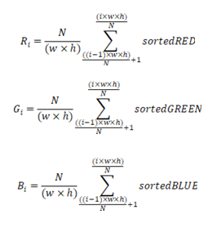

Slide 17
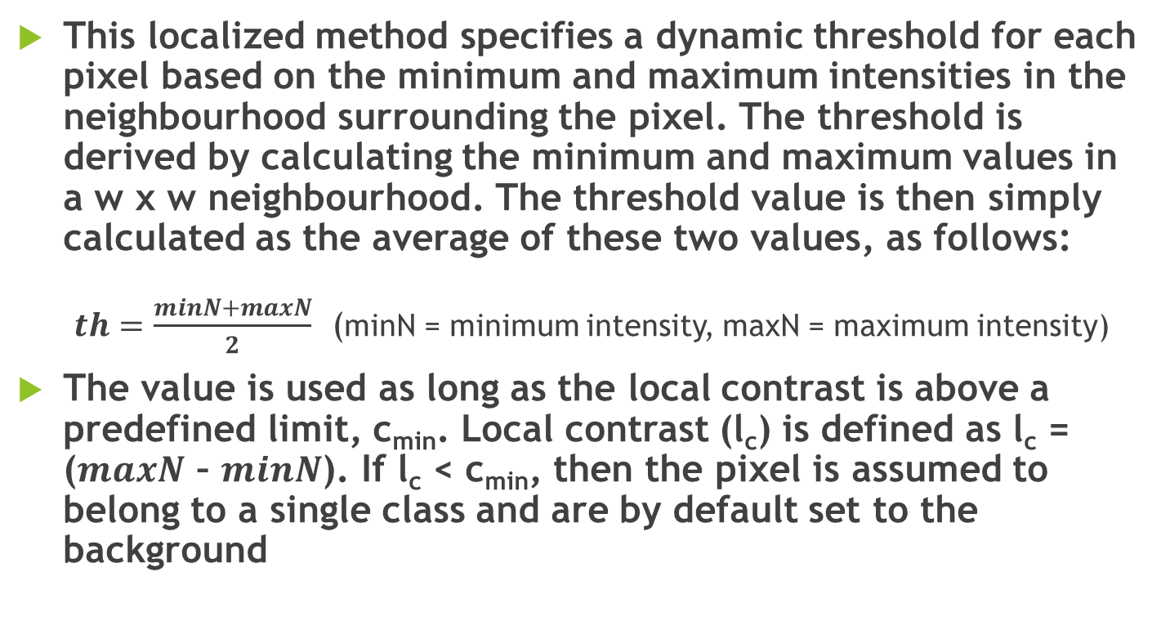
Bernsen Local Thresholding technique
This localized method specifies a dynamic threshold for each pixel based on the minimum and maximum intensities in the neighbourhood surrounding the pixel. The threshold is derived by calculating the minimum and maximum values in a w χ w neighbourhood. The threshold value is then simply calculated as the average of these two values, as follows:
$th=\frac{minN+maxN}{2}$ (minN = minimum intensity, maxN = maximum intensity)
The value is used as long as the local contrast is above a predefined limit, c_{min}. Local contrast (l_{c}) is defined as l_{c} = ($maxN$ – $minN$). If l_{c} < c_{min}, then the pixel is assumed to belong to a single class and are by default set to the background

Slide 18
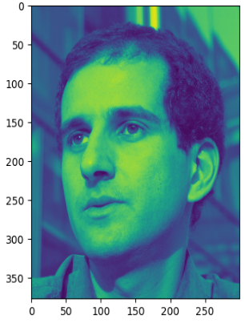
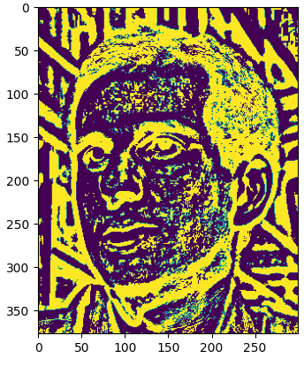
Implementation of Bernsen Thresholding method to produce a segmented image. The image on right is the input grayscale image while one on the left is segmented. (w=7 and c_{min} = 100)

Slide 19
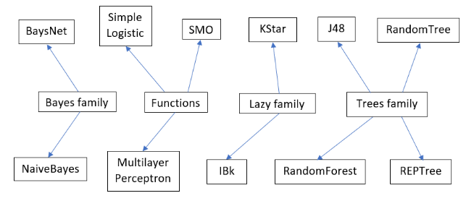
EXPERIMENTAL ENVIRONMENT
Machine Learning Alogrithms:

Slide 20
ENSEMBLES
Sr. No. | Ensembles
1 | RandomForest(RF) + RandomTree(RT) + Multilayer Perceptron(MP)
2 | RandomForest(RF) + RandomTree(RT) + REPTree
3 | IBk + Multilayer Perceptron(MP) + RandomForest(RF)
4 | RandomForest(RF) + RandomTree(RT) + IBk
5 | Random Forest(RF) + Random Tree (RT)+ IBk + KStar + J48

Slide 21
DATASETS
The architecture is tested using the WEKA (Waikato Environment for Knowledge Analysis) tool on following 2 datasets:
MICC-F220
MICC-F2000
Dataset | Composition | Sizes of Images | Size of Tampered Region
MICC-F220 | It comprises of 220 pictures divided into 110 spliced pictures and 110 original pictures. | Between 722 × 480 and 800 × 600 pixels | The region accounts for 1.2% of the whole picture.

Slide 22
Dataset | Composition | Sizes of Images | Size of Tampered Region
MICC-F2000 | It comprises of 2000 pictures divided into 700 spliced pictures and 1300 original pictures. | 2048 × 1536 pixels | The tampered region accounts for 1.12% of the whole image.

Slide 23
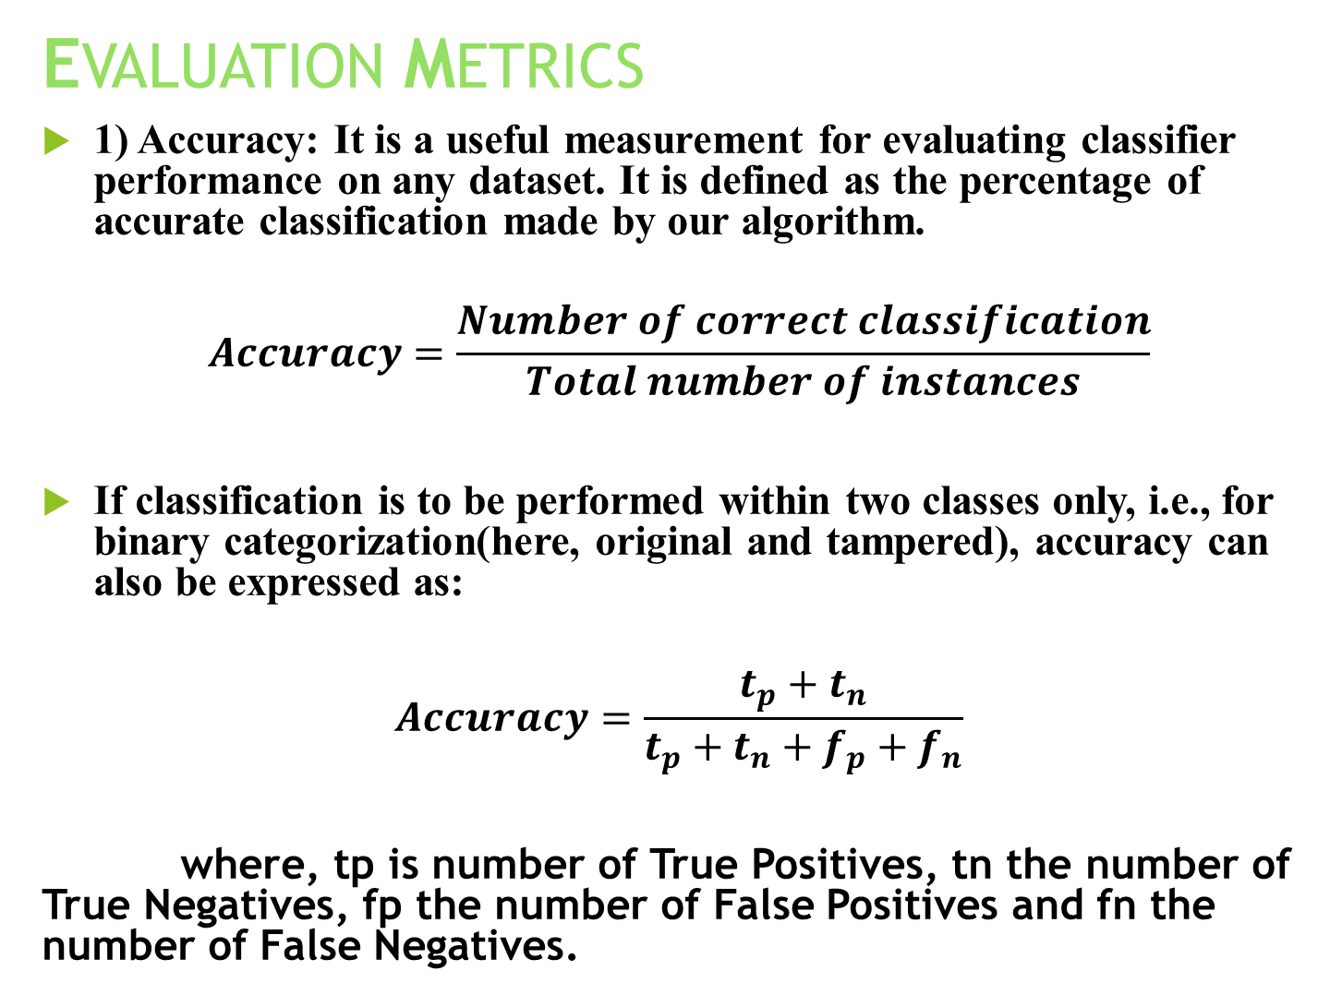
EVALUATION METRICS
1) Accuracy: It is a useful measurement for evaluating classifier performance on any dataset. It is defined as the percentage of accurate classification made by our algorithm.
$$Accuracy=\frac{Number of correct classification}{Total number of instances}$$
If classification is to be performed within two classes only, i.e., for binary categorization(here, original and tampered), accuracy can also be expressed as:
$$Accuracy=\frac{t_{p}+t_{n}}{t_{p}+t_{n}+f_{p}+f_{n}}$$
where, tp is number of True Positives, tn the number of True Negatives, fp the number of False Positives and fn the number of False Negatives.

Slide 24
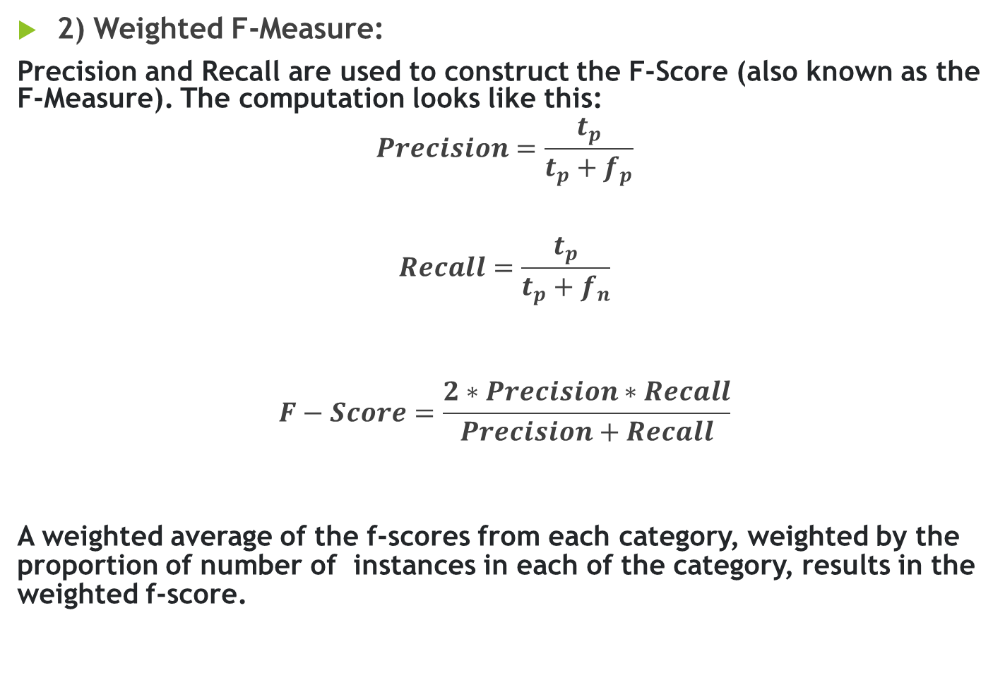
2) Weighted F-Measure:
Precision and Recall are used to construct the F-Score (also known as the F-Measure). The computation looks like this:
$$Precision=\frac{t_{p}}{t_{p}+f_{p}}$$
$$Recall=\frac{t_{p}}{t_{p}+f_{n}}$$
$$F−Score=\frac{2∗Precision∗Recall}{Precision+Recall}$$
A weighted average of the f-scores from each category, weighted by the proportion of number of instances in each of the category, results in the weighted f-score.

Slide 25
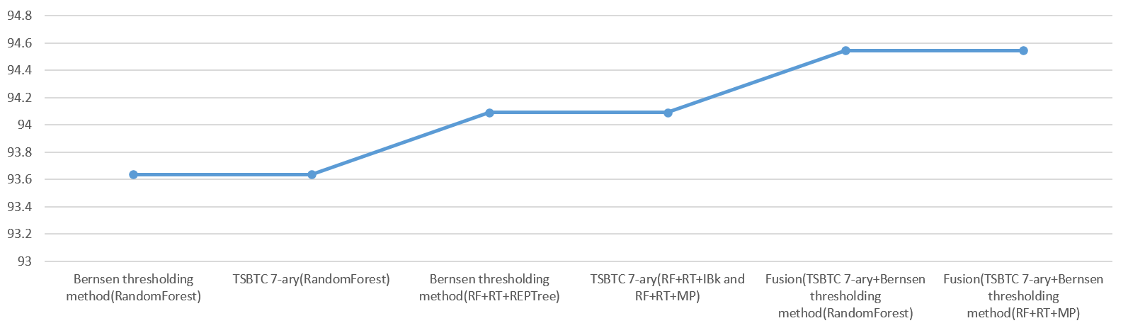
RESULTS 1) Analysis on MICC-F220
Demonstration of better results being yielded from the proposed model than the traditional individual methods on dataset MICC-F220. Fusion (TSBTC 7-ary + Bernsen thresholding method) trained on ensemble (RandomForest + RandomTree + Multilayer Perceptron) yields 94.5455% accuracy.

Slide 26
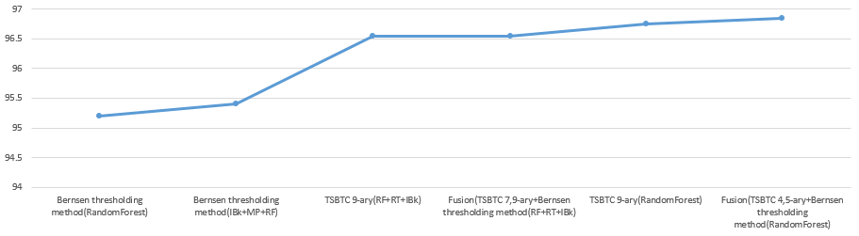
2) Analysis on MICC-F2000
Demonstration of better results being yielded from the proposed model than the traditional individual methods on dataset MICC-F2000. Fusion (TSBTC 4/5-ary + Bernsen thresholding method) trained on classifier - RandomForest yields 96.85% accuracy.

Slide 27
3) Analysis on MICC-F600
Similar analysis was also performed on MICC-F600. But the results obtained were inconsistent. The dataset of MICC-F600 consists of 600 images which are divided into following types:
440 Original images
40 images singly tampered
40 images multiple tampered
40 images singly tampered with 30 degree rotation of the tampered segment
40 images singly tampered with 30 degree rotation of the tampered segment and scaling it with a factor of 1.2
In the study it was found out that TSBTC N-ary technique gave highest accuracy than the proposed methodology viz. 96.3%, while Fusion (proposed) method yielded a max of 95.9%. Similar trend was observed for F-Measure metrics.

Slide 28
CONCLUSION
The proposed method was trained using various machine learning classifiers and their ensembles in WEKA tool.
For MICC-F220, overall best performance was attained by Fusion of TSBTC 7-ary vector and the vectors obtained from Bernsen thresholding, 94.5455%. While F-Measure for same was found to be 0.945, which was the highest in entire metrics.
For MICC-F2000, overall best performance was attained by Fusion of TSBTC 4/5-ary vector and the vectors obtained from Bernsen thresholding, 96.85%. Similarly, F-Measure was found to be 0.969, which was again the highest.
The main disadvantage of recommended architecture is that it is produces dataset-dependent results.

Slide 29
REFERENCES
[1] Abrahim AR, Rahim MSM, Bin SG (2018) Splicing image forgery identification based on artificial neural network approach and texture features. Cluster Comput:1–14. https://doi.org/10.1007/s10586- 017-1668-8
[2] Asghar K, Habib Z, Hussain M (2017) Copy-move and splicing image forgery detection and localization techniques: a review. Aust J Forensic Sci 49:281– 307. https://doi.org/10.1080/00450618.2016.1153711
[3] Image Forgery Detection – A survey by Hany Farid: IEEE SIGNAL PROCESSING MAGAZINE.
[4] Badre, S. R., and S. D. Thepade. 2016. Novel video content summarization using thepade’s sorted n-ary block truncation coding. Procedia Computer Science 79:474–82. doi:10.1016/j.procs.2016.03.061.
[5] Sudeep D. Thepade & Piyush R. Chaudhari (2021) Land Usage Identification with Fusion of Thepade SBTC and Sauvola Thresholding Features of Aerial Images Using Ensemble of Machine Learning Algorithms, Applied Artificial Intelligence, 35:2, 154-170, DOI: 10.1080/08839514.2020.1842627

Slide 30
THANK YOU!

